Slide 1



GigaSpaces - Predictive Maintenance Nadav Gross & Or Aharoni June 2019

Slide 2


About GigaSpaces
300+
We provide the leading in-memory computing platforms for real-time insight to action and extreme transactional processing. With GigaSpaces, enterprises can operationalize machine learning and transactional processing to gain real-time insights on their data and act upon them in the moment.
Direct customers
50+ / 500+
Fortune / Organizations
5,000+
Large installations in production (OEM)
InsightEdge is an in-memory real-time analytics platform for instant insights to action; analyzing data as it's born, enriching it with historical context, for smarter, faster decisions
In-Memory Computing Platform for microsecond scale transactional processing, data scalability, and powerful event-driven workflows
25+
ISVs
Notes:
Founded 18 years ago
Pioneers of in-memory computing technology
Digitalized Wall Street
As data and requirement for extreme transactional, real-time applications has grown, we have expanded to many new markets

Slide 3
WHAT DO WE DO?
Build a ML algorithm to predict the health of a certain machine.
Notes:
The most simplified real-time analytics platform for smarter and faster insights to action:
Unifies advanced analytics and AI (leveraging complete Spark for ML and leading DL frameworks) with transactional (ACID) and operational data without interrupting business operations
Low latency access to real-time and historical data for smarter and faster Machine Learning analytics from one interface (simplified Lambda architecture)
Integrates various data sources (structured, semi-structured and unstructured - text, geospatial, sensor, tables, docs…)
Event driven analytics and business logic – trigger the right actions at the right instant
ANSI SQL-99 compliant – for business analysts and easy connectivity for BI tools
Ultra-low latency and high-throughput transaction & stream processing and analytics, transforming applications into disruptive opportunities: Millions of events per second at sub-second response time
Proven mission critical availability – proven no downtime at leading financial institutions, ecommerce sites and transportation agencies
Optimized TCO: Intelligent multi-tiered storage with latest SSD/persistent memory

Slide 4
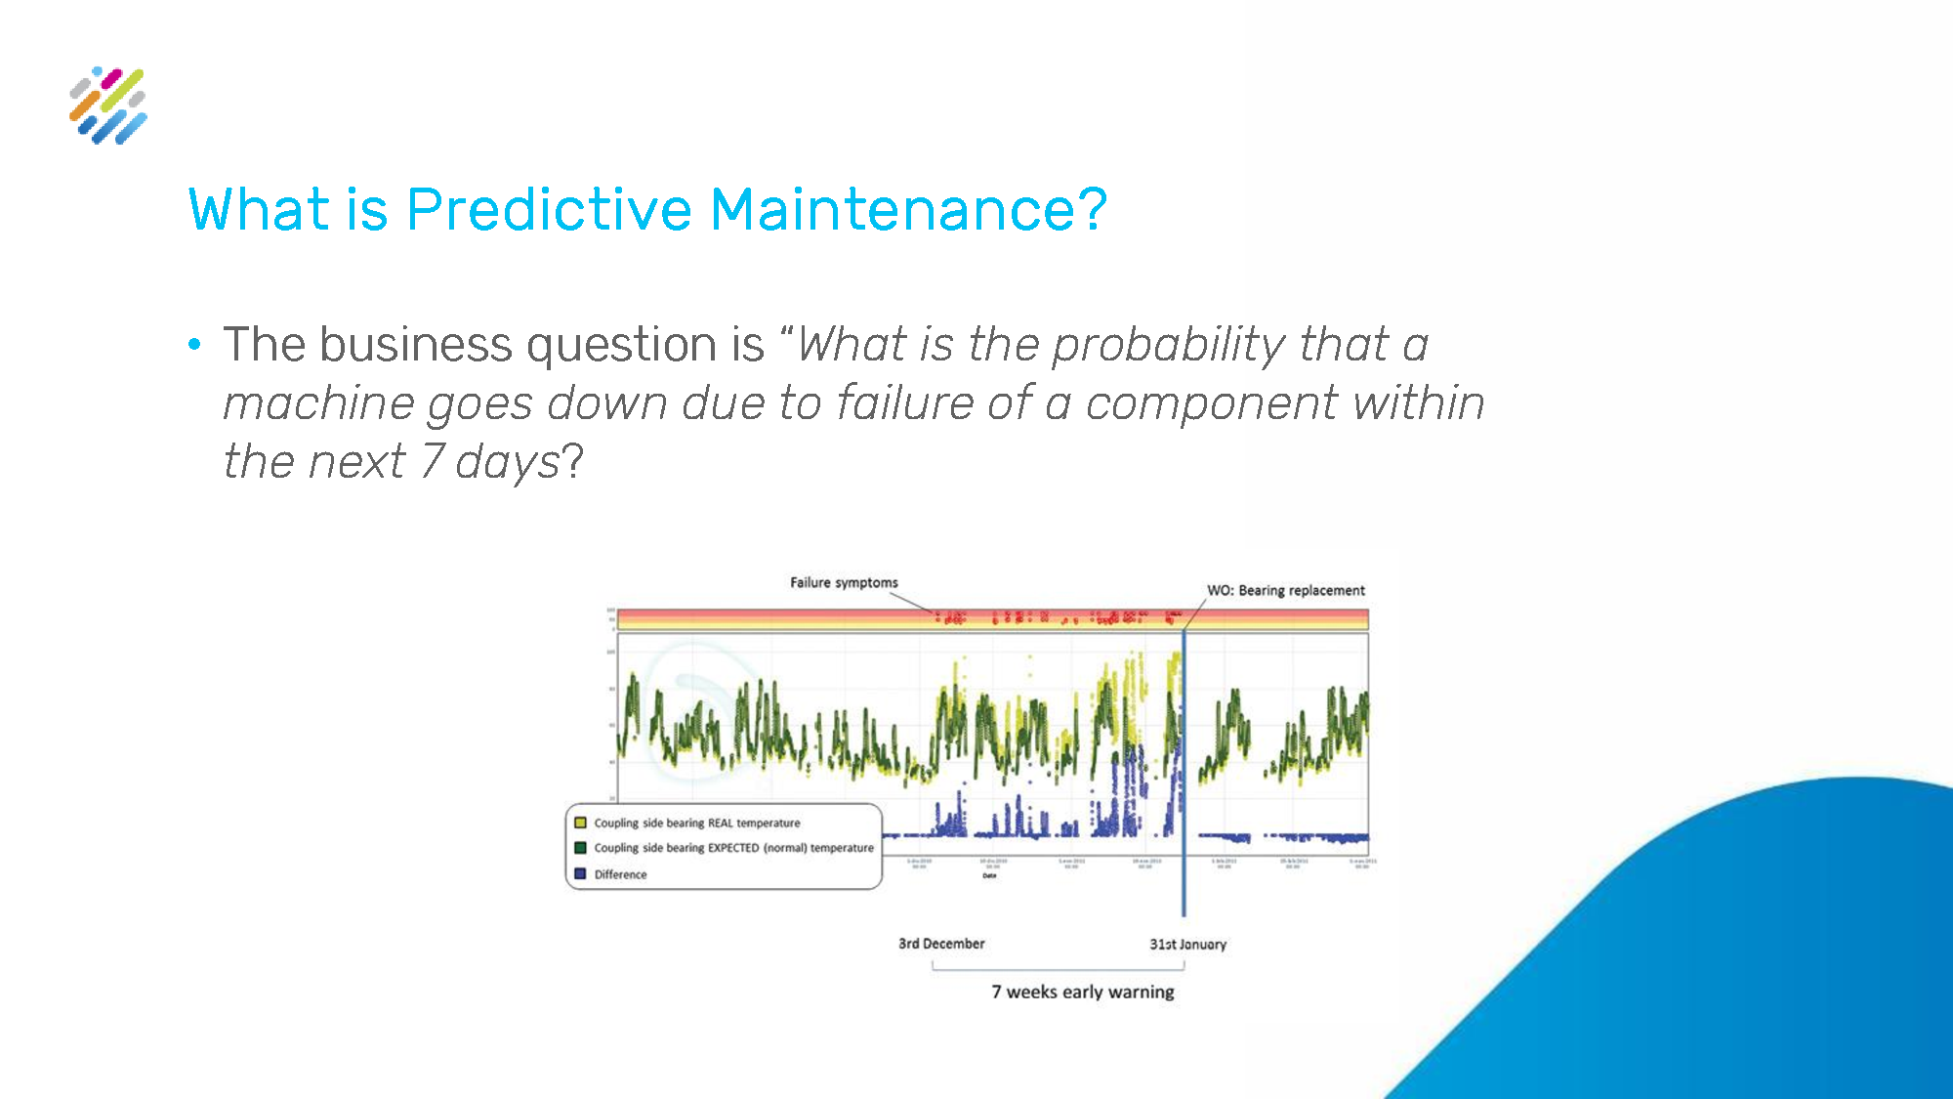

Slide 5
The Technologies
InsightEdge
Microsoft Azure
Tableau
Apache Spark
Zeppelin Notebook

Slide 6
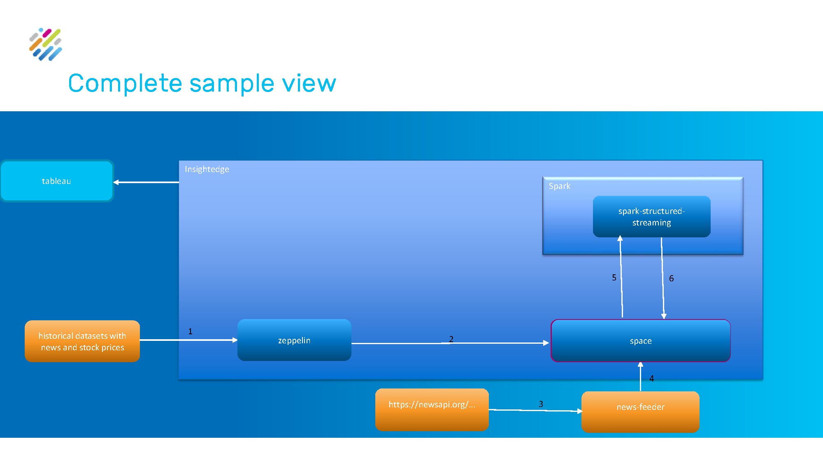

Slide 7
HOW?
The Steps We Took:
The Data Phase:
Exploring the data using Zeppelin Notebook and Pandas.
Build feature vectors from the five files we had.

Slide 8
Data
The Data We Used
Machines
Machine ID --- Model --- Age
Errors
DateTime --- Machine ID --- Error ID
Maint
DateTime --- Machine ID --- Comp
Failures
DateTime --- Machine ID --- Failure
Telemetry
DateTime --- Machine ID --- Volt --- Rotate --- Pressure --- Vibration

Slide 9
Features
Some Of The Features We Used
Components Summary
How many days have passed since the last maintenance for all type of components.
Errors Summary
How many errors from each type have occurred in the last timestamp.
Voltage Changes
The changes per timestamp (12,24,36) of the Voltage sensor.
Pressure Changes
The changes per timestamp (12,24,36) of the Pressure sensor.
Rotation Changes
The changes per timestamp (12,24,36) of the Rotation sensor.
Vibration Changes
The changes per timestamp (12,24,36) of the Vibration sensor.

Slide 10
HOW?
The Steps We Took:
The Data Phase:
Exploring the data using Zeppelin Notebook and Pandas.
Build feature vectors from the five files we had.
The Model Phase:
Building the model using spark, a decision tree model, trained using the features from the step before.
Evaluating the model, splitting the data to 80% training set and 20% test set.

Slide 11
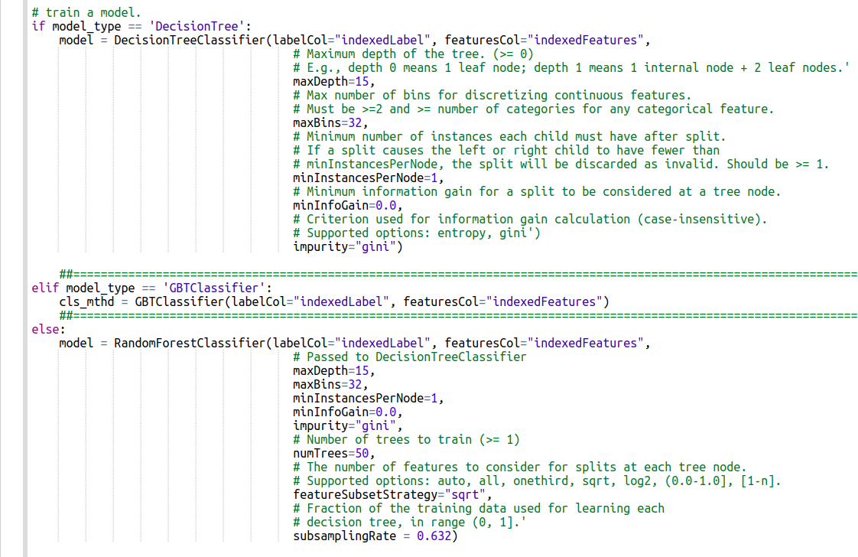
MODEL
The Model
In this step we tried three different models to choose from:
Decision Tree Model.
GBT Classifier.
Random Forest Classifier.

Slide 12
HOW?
The Steps We Took:
The Data Phase:
Exploring the data using Zeppelin Notebook and Pandas.
Build feature vectors from the five files we had.
The Model Phase:
Building the model using spark, a decision tree model, trained using the features from the step before.
Evaluating the model, splitting the data to 80% training set and 20% test set.
The Visualisation Phase:
Using Tableau, we visualize the results, and the predictions in some graphs to indicate our conclusions.

Slide 13
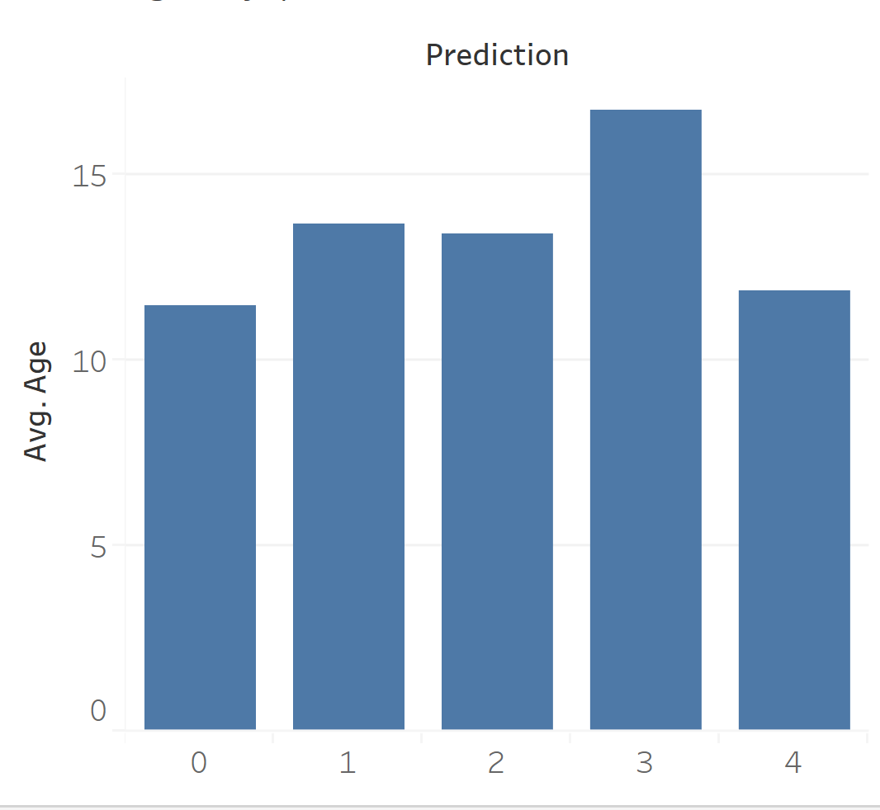
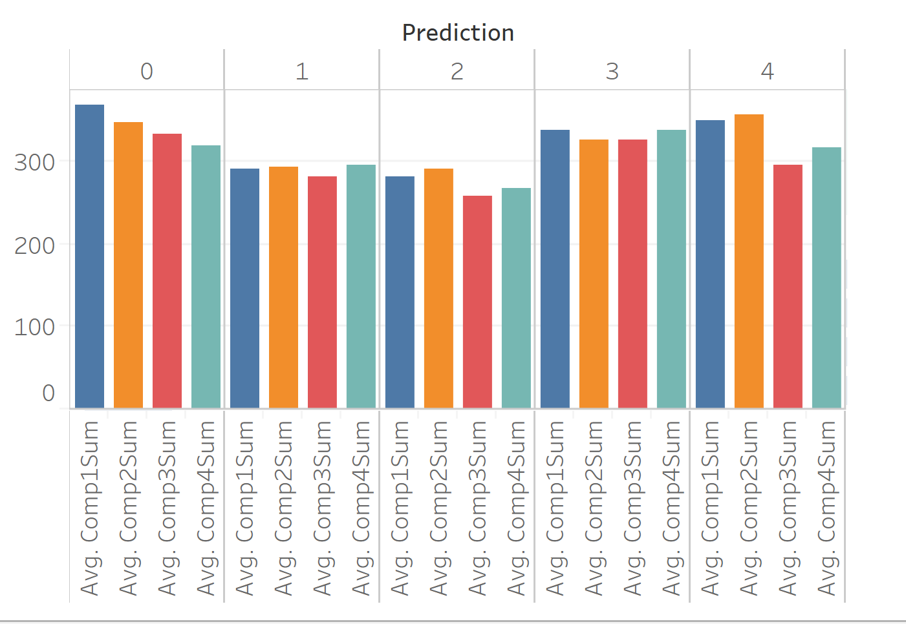
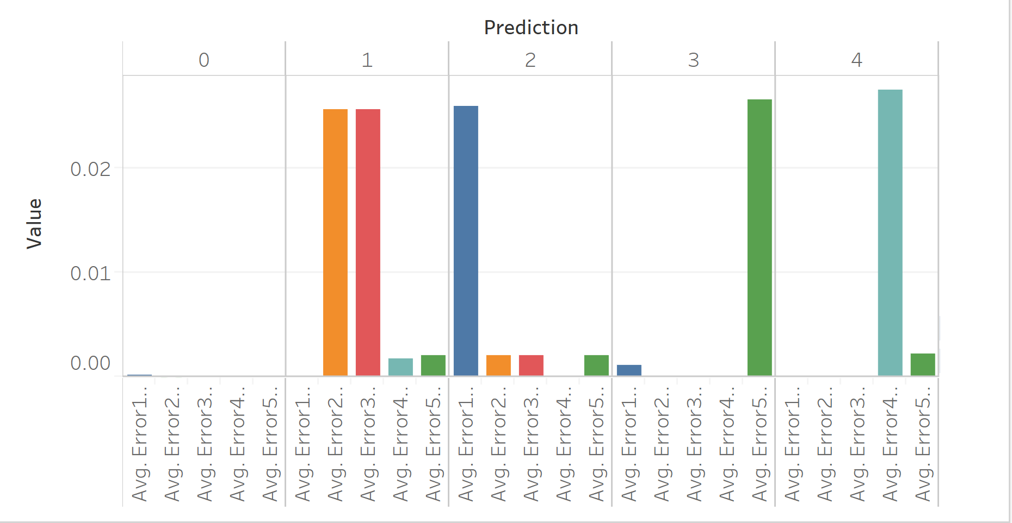
RESULTS!
Tableau - Visualisation
Average age of the machines by prediction
Average maintenance to a component by prediction
Average times an error has occurred per type by prediction

Slide 14
CHALLENGES
The Challenges We’ve Encountered:
The Data Phase:
Find useful data to use.
Thinking about the correct features to use in order to get best results.
The Model Phase:
Trying different models, evaluating them in order to find the best resulting model.
Converting our code to fit the InsightEdge product, the things we changed were making the data off-heap and make the data load on initialize, using the memoryXtend technology..
convert the code from python3 to python2.7.
The Visualisation Phase:
Connecting Tableau to InsightEdge, think of useful graphs to display to the user, the graphs had to have useful informations.

Slide 15
Summary
We used Zeppelin Notebook and PySpark to code and build the model.
We used Tableau and InsightEdge to evaluate the model and show its results.

Slide 16


THANK YOU
TRY IT

